Slide 1
Attitude measurements based on direct solar irradiance vector
Student: Collin Krawczyk
Mentor: Michael Shafer – Assistant Professor of Mechanical Engineering

Slide 2
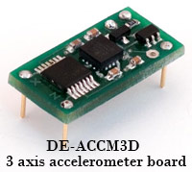
Background
Accelerometer
Device that measures orientation
Used in all devices
Accelerometer Problem
Erratic Motions
Reference Frames
Figure 1: Accelerometer [1]

Slide 3
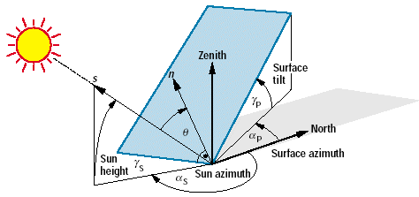
Objectives
Solar Panels
Solar Vectors
Sun Azimuth
Horizontal angle from North to sun position
Elevation Angle
Vertical angle to the Sun from horizontal
Surface Tilt
Vertical angle to the panel from horizontal
Latitude and Longitude
Known GPS coordinates can determine location of the sun
Earth based system
Figure 2: Sun angles [2]

Slide 4
Equipment Used
Artificial Sun and Source Meter
Located in dynamic and active systems lab (DASL)
Solar Panels
Found within the DASL lab
3D Printed Solar Panel Design
From past capstone
Figure 5: Artificial Sun
Figure 3: Solar Panel
Figure 4:Keithley Source Meter

Slide 5
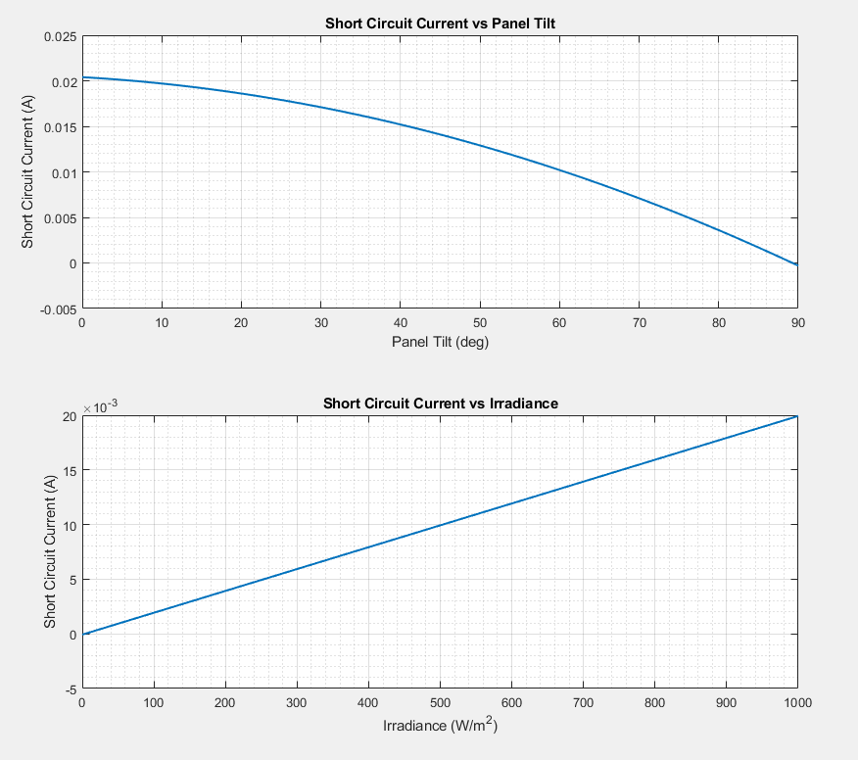
Solar Panel Characterization
Irradiation
Energy that is hitting the panel
Run trials to determine current
With fixed irradiance
With fixed panel tilt
Figure 6: Solar Panel Characterization

Slide 6
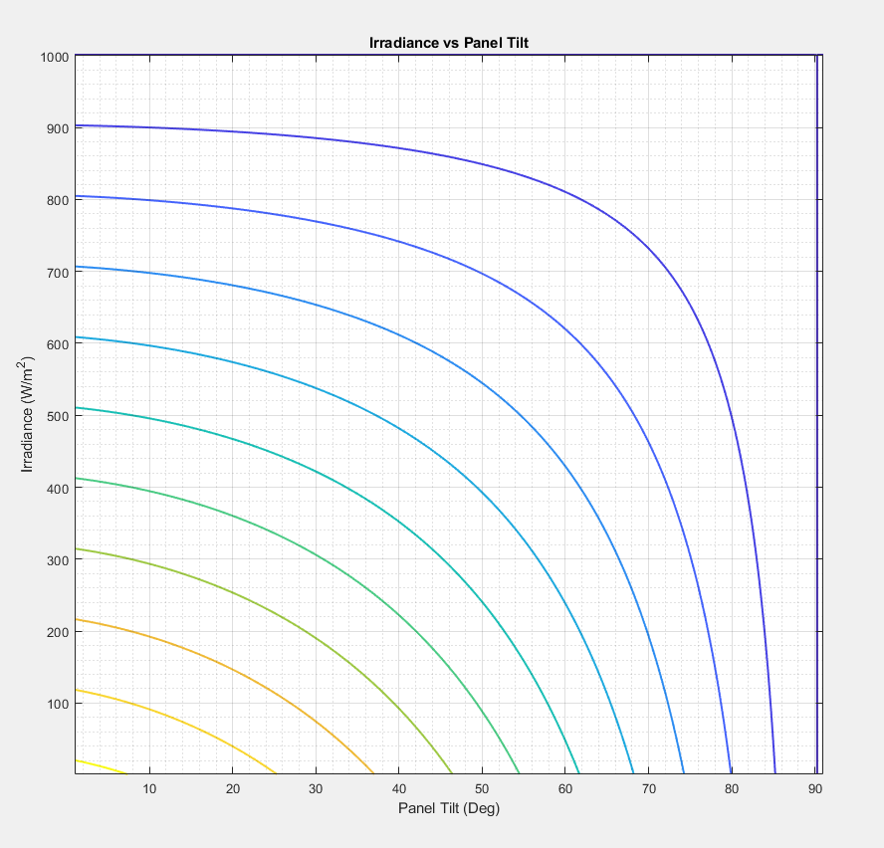
Tabulated Current
Combination of past 2 graphs
Allows for searching of currents
Figure 7: Current Table

Slide 7
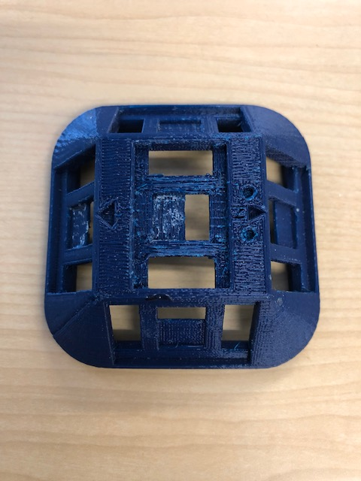
Results
Possible to get angles of panels for 2D
Outside testing
Current inputs corresponding to irradiance
Narrow down panel tilts
Irradiance values given by location
Figure 8: Example panel tilts given an irradiance
Figure 8: 3D printed solar panel device

Slide 8
Conclusion
Use of solar panels for applications in Earth based systems to obtain orientation
Applications
Animals
Electronics
Vehicles
Future Work
Three-Dimensional

Slide 9
Acknowledgements
NAU/NASA Space Grant
Providing funds and this opportunity
Michael Shafer
Providing mentorship, knowledge, and access to the DASL lab

Slide 10
References
[1] “A beginner's guide to accelerometers,” Dimension Engineering. [Online]. Available: https://www.dimensionengineering.com/info/accelerometers. [Accessed: 27-Feb-2019].
[2] V. Quaschning, “The Sun as an Energy Source,” Volker Quaschning. [Online]. Available: https://www.volker-quaschning.de/articles/fundamentals1/index.php. [Accessed: 27-Feb-2019].

